Slide 1

How will your neighbourhood share energy?
Heather Smith 6 November 2021
Coalition for Community Energy
Notes:
Reflect on feedback from what energy system will look like?

Slide 2



Centralised Electricity System
Network of Small Systems (Microgrids)
OR
Notes:
Put notes here – insights from participants
What does it really mean? – exploring the polarities of centralised and decentralised
Big government, big market, ??big community
How much will be cookie cutter? How much unique?

Slide 3
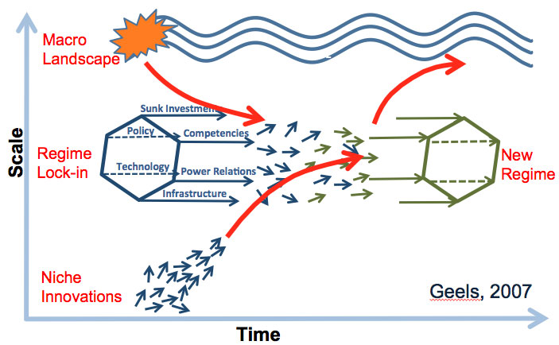
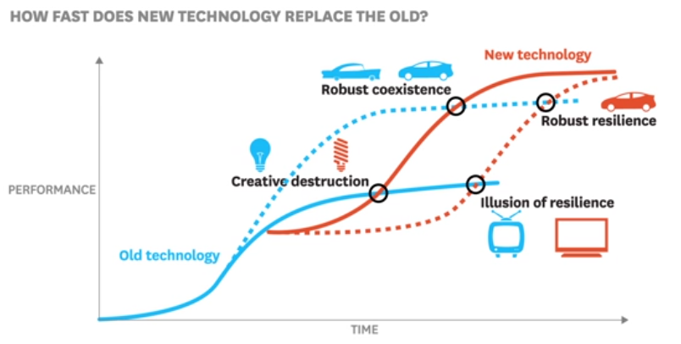
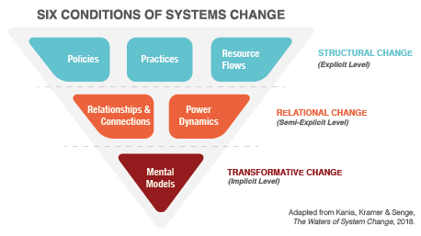
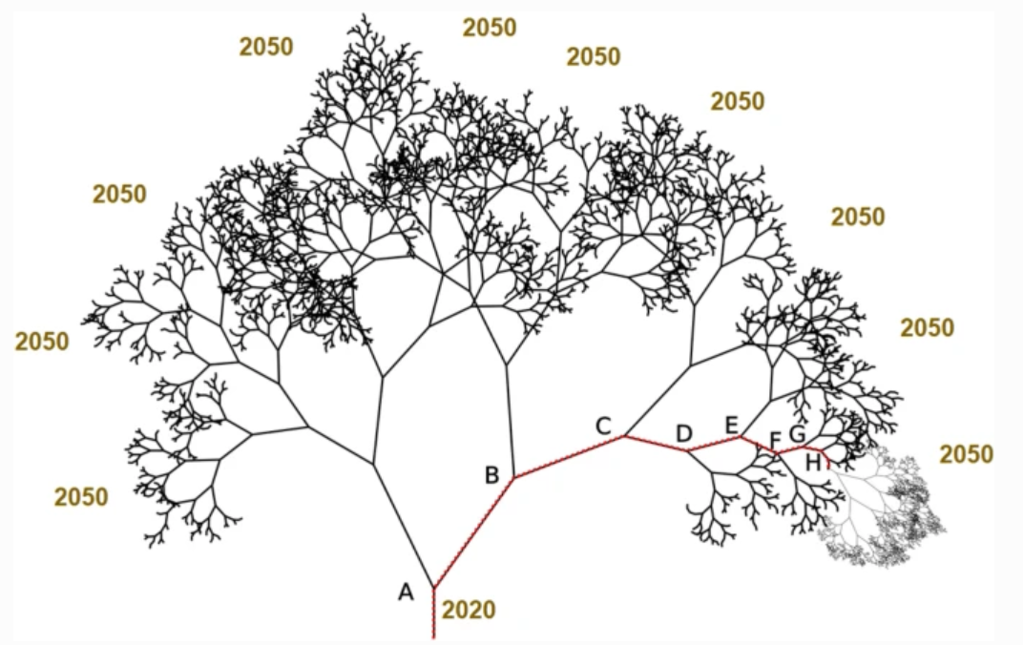
Transition is messy – and complex
Notes:
Climate change forces us to accelerate., to a tipping point of sorts
All over the internet we find images of destructive change, winners and losers, revolution
Climate change imperative. Transition needs to be rapid
Innovation/transition perspective. Transformative change involves creative destruction (Schumpeter)
Energy is a society-wide system, fundamental to societal structure
We are facing a revolution with an unknown outcome
Paradigmatic shifts
Those steeped in the paradigm struggle to move out of it
New paradigm often emerges in multiple places at the same time
Socio-technical transitions
Niches need to flourish, the regime falls apart and re-creates itself
Path dependence of systems
Complex systems evolve, adapt, self-organise, have redundancy, can shift to a new stable state.
Innovation Framework (* chosen as the main conceptual foundation *)
An opportunity to create value needs to be designed…
By a team with diverse skills and perspectives…
With a business model / resources / authority / social support / legitimacy
Design for transition can be a catalyst for change
Interventions, designing for…
Government, Market and Community to unlock public, private and collective value

Slide 4
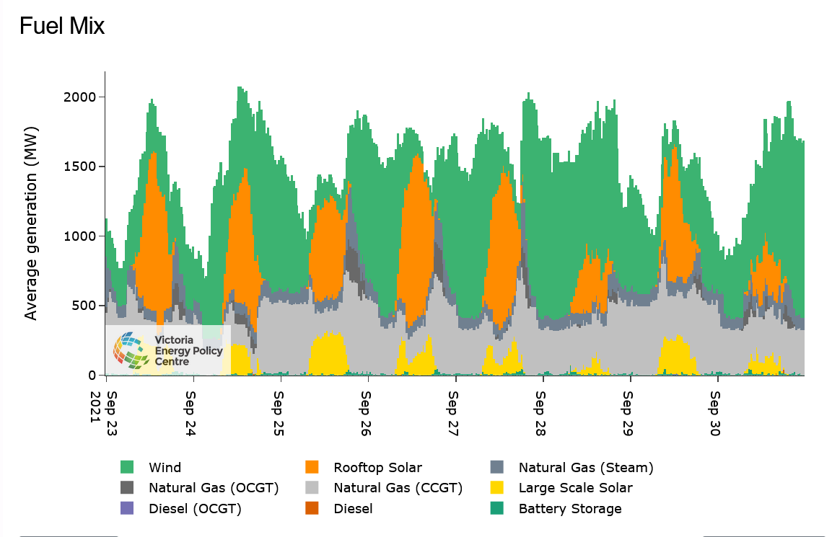
http://nemdashboard.com.au/

Slide 5
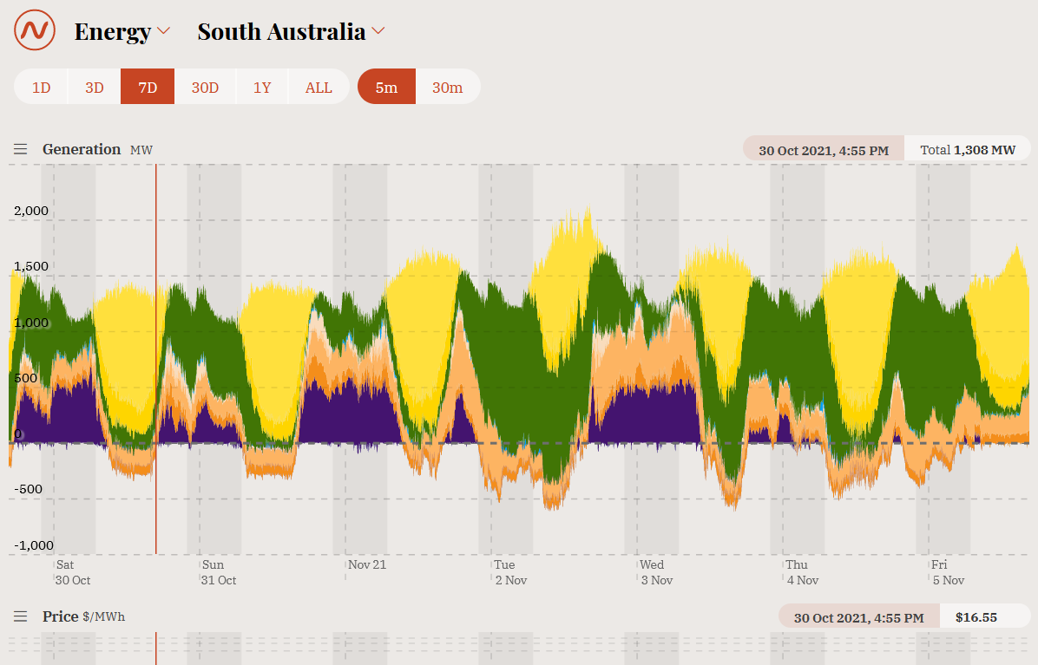
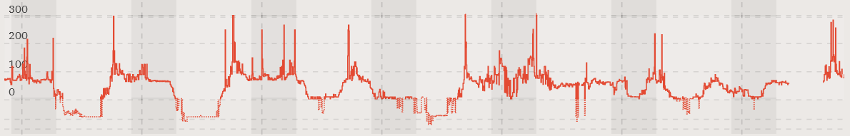
https://opennem.org.au
Notes:
Rooftop Solar only 15% across the whole year

Slide 6
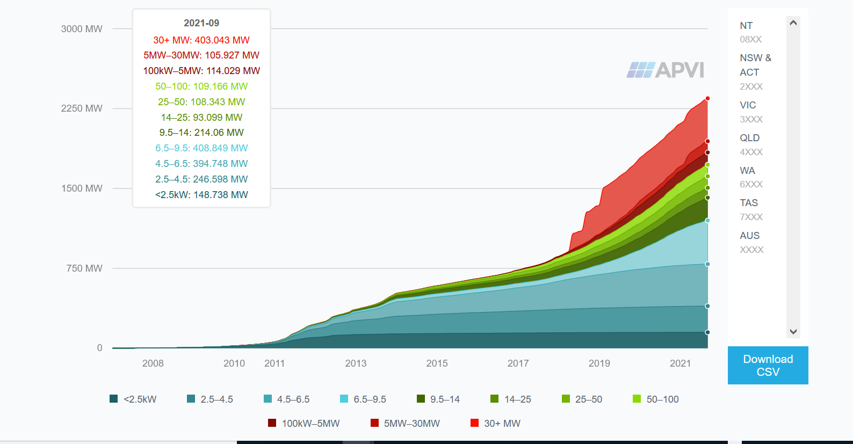

Slide 7
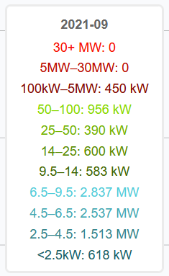
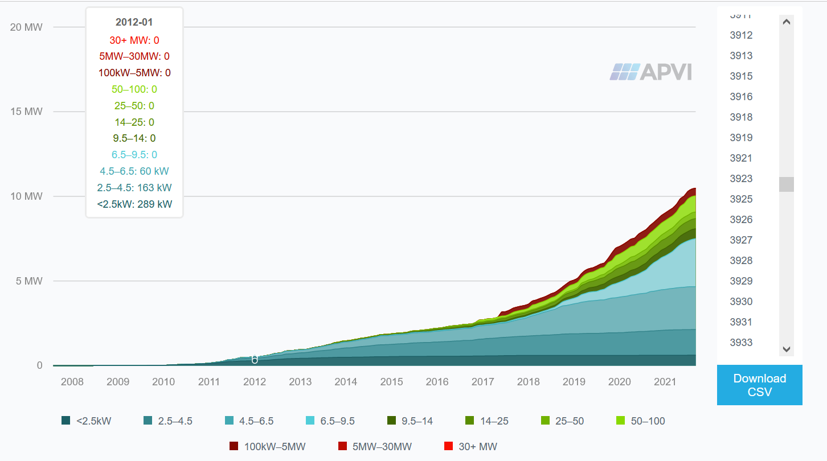
Postcode 3922 – Philip Island
Stats for September 2021
1,815 installations
~ 38% homes
(+ some businesses)

Slide 8
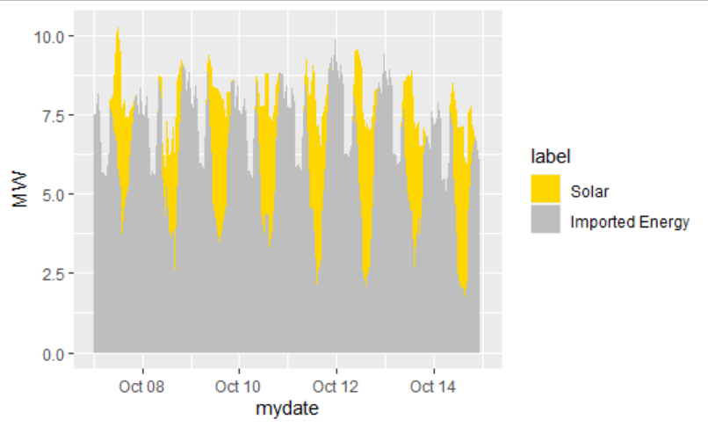
Phillip Island
– sunny week in October
Notes:
Talk about value in diversity
Ie sharing

Slide 9
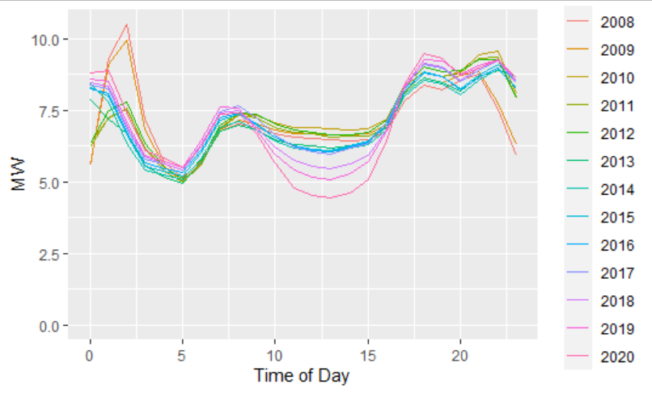
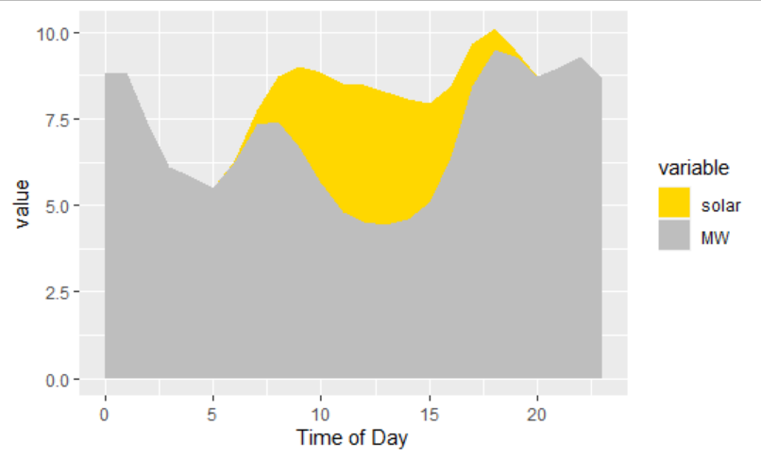
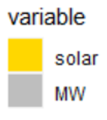
15% solar in 2020

Slide 10
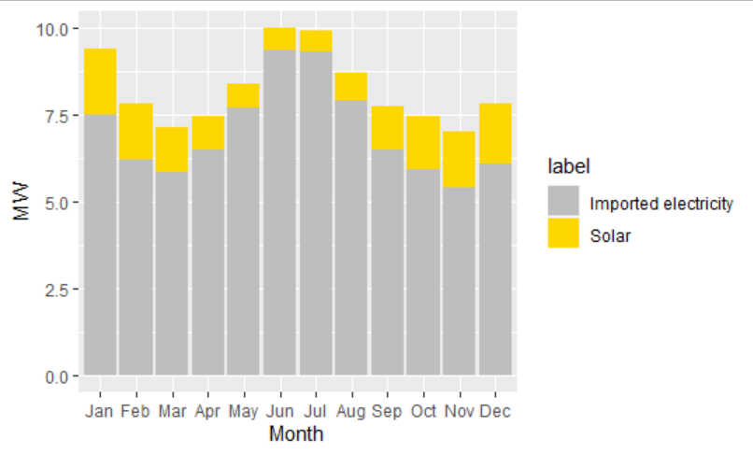
23% solar
6.3% solar

Slide 11
What could self-reliance look like?
Prepare for new loads..
Electric Vehicles
Getting off Gas
More Solar
Diverse Generation
Eg Wind
Energy Efficiency

Slide 12
What could sharing look like?
Source external renewables (link to market)
Control new load to best use surplus renewables
Shift Loads eg Hot Water
Storage to use surplus
Some sharing happening already – 50%?
Solar Surplus

Slide 13
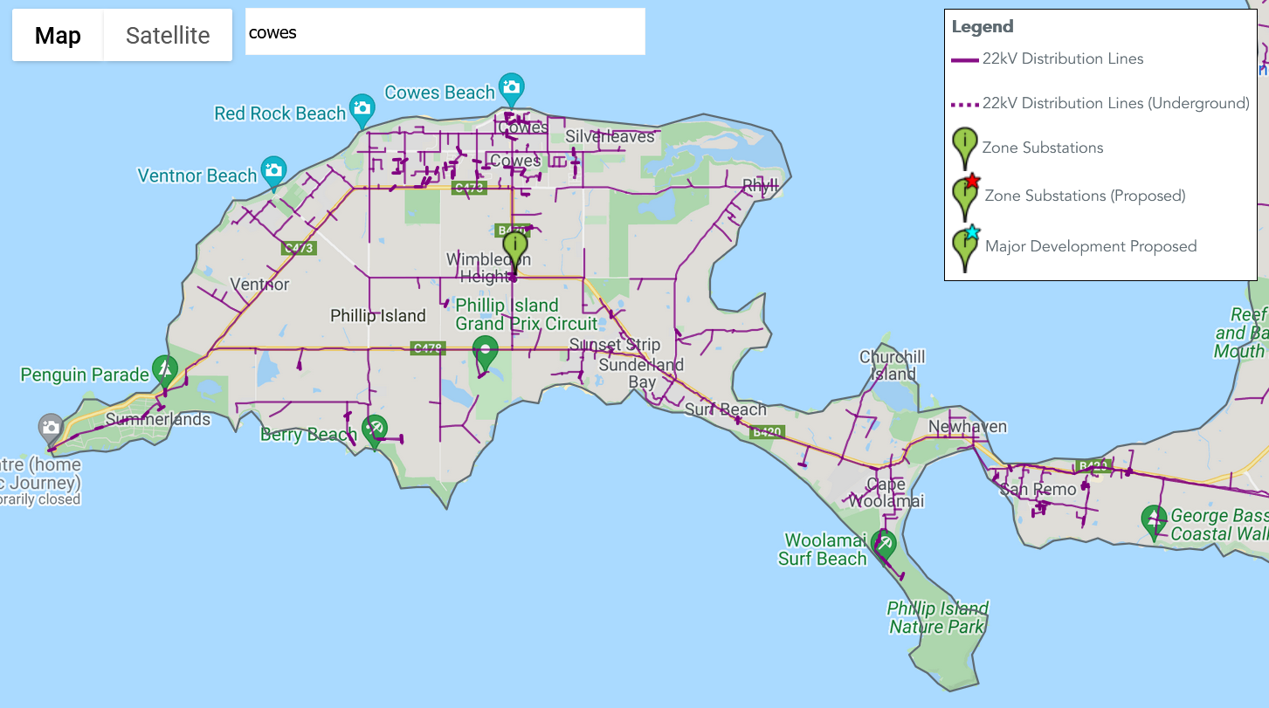
Phillip Island Zone Substation
26 MVA

Slide 14
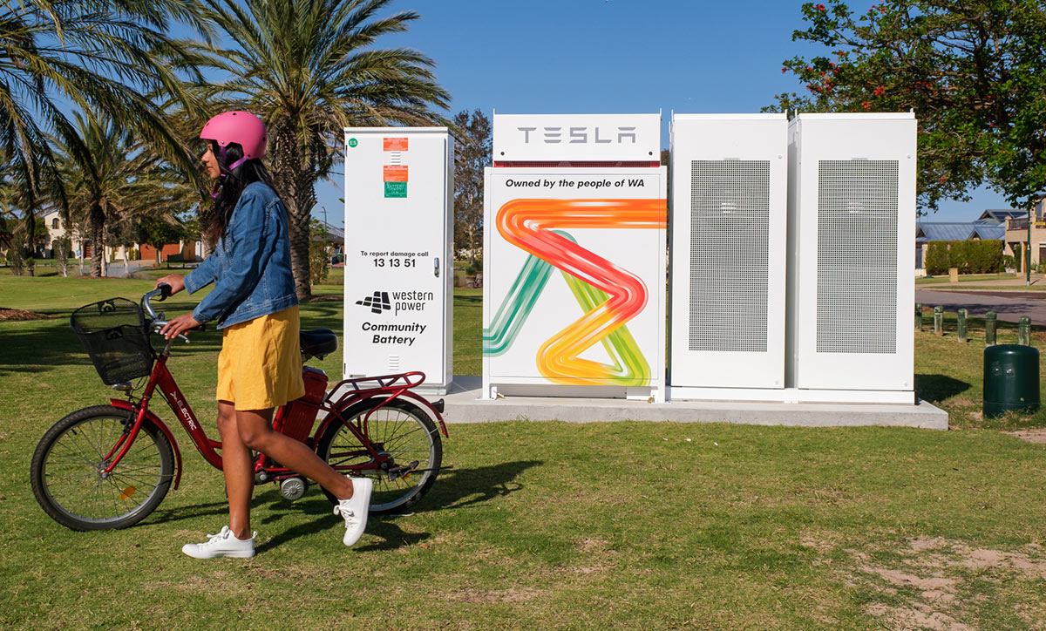



Zero Emissions Noosa battery report
SOURCES OF VALUE
Matching supply with demand
  demand management
  freeing up capacity
  deferred and avoided investment in network and centralised generation
  local voltage support
Responding to sudden changes in the supply / demand balance.
  Unlocking commercial value would involve access to Frequency Control markets and the capability to bid appropriately.
Power quality
  there may be local power quality benefits. The possible issues and the control arrangements to unlock benefits would need to be investigated further.
Back up supply to serve loads in emergencies and improve reliability
Non-market (societal) value.
Noosa

Slide 15
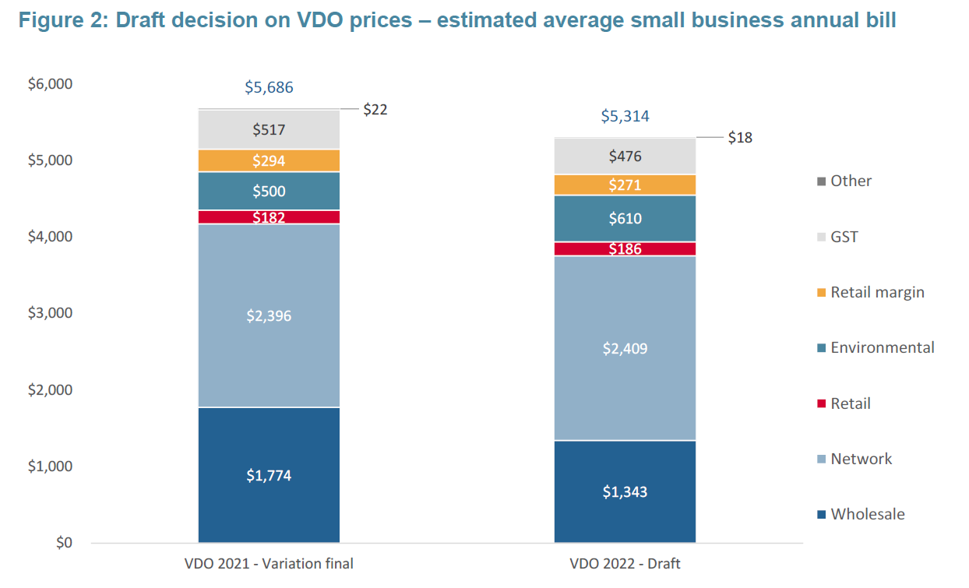
Supply match demand
Your charges – value stack

Slide 16
Benchmarks - Cost
                Back up supply
                residential
                (behind the meter)
                business
                (behind the meter)
                Local is best!
                Unbeatable!

Slide 17
Activities that create sharing value
Energy Efficiency
  make loads, smart, flexible and controllable at the same time
New loads – incentives to ensure “smart, flexible and controllable“
Shift loads – eg hot water
  Another form of storage
Storage Capacity
Access to wholesale market incentives (when required)

Slide 18
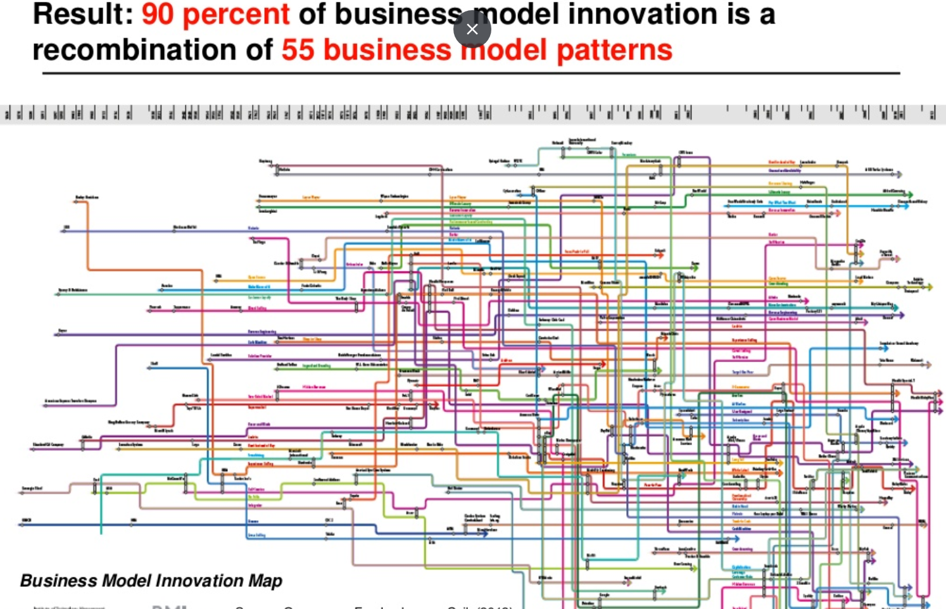

Slide 19






Retail options and business models
  REVENUE SHARING
  (inc virtual power plants)
  Managing Supply Chain
  Manage Customer Value
    SUBSCRIPTION – Alkimos Beach
    LEVERAGE CUSTOMER DATA
    HIDDEN REVENUE

Slide 20

Retail options and business models – cont.
  Change the cost of kWh
    FLAT RATE (take the risk)
    NO FRILLS
    FREEMIUM
    ROBIN HOOD
    ADD ON

Slide 21
Retail options and business models – cont.
  Manage high capital costs
    RENT INSTEAD OF BUY
    PAY PER USE
    FRACTIONAL OWNERSHIP
    GUARANTEED AVAILABILITY
    Monopolies
    Investment

